Slide 1
Can Reinforcement Learning Be Applied to Surgery?
Agostino Aiezzo - 982514

Slide 2

A bit of context
A simple 2D task that mimics a hysterectomy
The Environment is a 10x10 matrix with the uterus at the center and ligaments and arteries all around.
The Agent is a knife whose objective is to navigate in the peritoneum and cut the target points.

Slide 3
The Agent
A pure DQN algorithm
A simple model with few parameters (at least, far less than the original one).

Slide 4
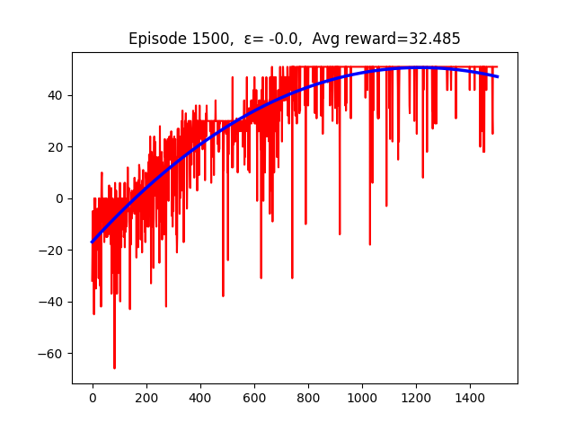
Final discussions
Optimal performances at 1500 episodes (theoretically, even less)
More complex environments (more ligaments and arteries, objects with different shapes and in a different position, etc.)
Possible improvements:
an even simpler and efficient model
a more sophisticated variant of DQN
The total reward at each episode and the correspondent trend line.

